Slide 1
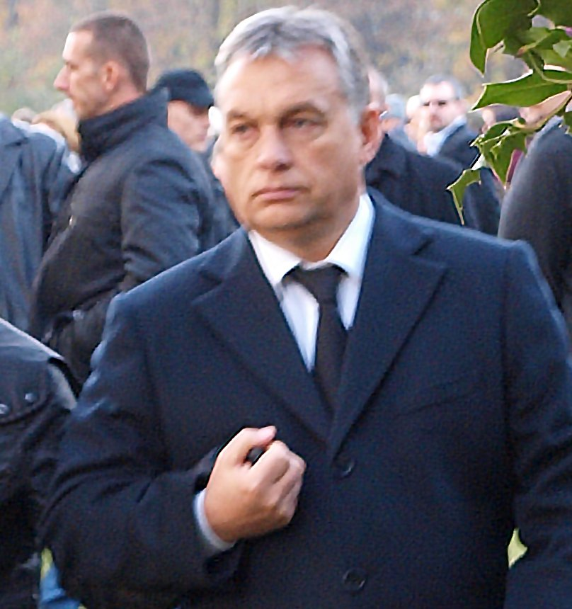
Fraud? Where? Evidence? (What to do?*)
The 2018 and 2019 Hungarian election vote counting in a nutshell, on a statistical basis
(* yet to be translated)
Version 2.4.
Partial translation

Slide 2
2019.

Slide 3
Fidesz Wins (May 26. 2019.)
Fidesz: 52,56% (42,1% - 55,08%)
DK: 16,05% (6%-11%)
Momentum: 9,93% (3%-7%)
MSZP-Párbeszéd: 6,61% (8,51%-13,3%) *
Jobbik: 6,34% (9,7%-13%) **
LMP: 2,18% (3%-5%) ***
* Századvég – in May – has measured 7,5%
** Závecz - in April - has measured 6%
*** MR Center: 1,8% in May, Medián: 7% in March/April
Poll results in parentheses (extreme, outlier looking values excluded, see footnote)
Values falling outside the reasonably expected range are in bold. Source: Wikipedia

Slide 4
Number of electoral wards and delegates
10,277 wards
Opposition party delegates were only present in 6948 (Index: 14,000 Fidesz, 12,000 opposition delegates were distributed)
1,365 of these were civic (by the “Számoljuk együtt” NGO)
Trivia: LMP, for example, could only delegate 149 people
The OSCE has not contributed observers this time
Sources:
Platón Párt adatigénylés Index (delegáltak számáról)
Index (EBESZ) Számoljuk együtt

Slide 5
Concerns
Open Democracy voices concerns in expectation – based on the 2018 election (written on 23 May 2019) article
A data analysis in progress (as of 18 Sep. 2019) raises at the very least the strong suspicion of the systemic manipulation of by the eye 150-220 thousands of the Fidesz vote counts
A small-scale facebook poll at the time writing (06/08/2019) suggests that every 4th person is willing to explicitly claim they believe that an election fraud has taken place

Slide 6
The Data Analysis

Slide 7
Method, Results
The analysis relies on numeric election data, a number of suspicious signs have been rendered probable in case of the municipalities that seemed feasible for the examination (these were typically cities).
For this, only the last digits of the vote counts were leveraged.
The more and less suspicious entries of the cumulative list (about 50%) have been plotted on “statistical electoral fingerprint” charts.

Slide 8
Method, Results
Having plotted the results from 2010 - albeit, if things are the work of randomness, there likely shouldn’t - a definite difference shows up - increases by 2014, then drastically changes in nature for the 2018 and 2019 results.
The 2010, 2014, 2019 differences seem to be a distortion, even a new, separate shape seems to appear in 2018.
The coincidence of the appearance of the distortion and the the symptoms of numeric tampering (based on which the municipalities were grouped) can be well explained by systematic, repeated, large scale fraud.

Slide 9
Wall of Shame
Congratulations! “There’s almost surely something about these municipalities…” ☺ A more verbose list - the more suspicious ~half, can be found in this doc. A ward level list is likely to come, too ☺
Rank | Municipality | Score |  | Rank | Municipality | Score
1 | Eger | 0 |  | 11 | Pécel | 0
2 | Berettyóújfalu | 0 |  | 12 | Veresegyház | 0
3 | Vecsés | 0 |  | 13 | Százhalombatta | 0
4 | Maglód | 0 |  | 14 | Lenti | 0
5 | Balatonfüred | 0 |  | 15 | Baja | 0
6 | Fót | 0 |  | 16 | Gyömrő | 0
7 | Tata | 0 |  | 17 | Dombóvár | 0
8 | Budapest XVI. | 0 |  | 18 | Putnok | 0
9 | Ócsa | 0 |  | 19 | Békéscsaba | 0
10 | Bátonyterenye | 0 |  | 20 | Budapest XXIII. | 0

Slide 10
Notaries of the Wall of Shame
While it is uncertain if they are responsible, maybe they could be contacted to find out what may have happened to those naughty numbers:
Rank | Municipality | Notary |  | Rank | Municipality | Notary
1 | Eger | Dr. Kovács Luca |  | 11 | Pécel | Oláh János
2 | Berettyóújfalu | Dr. Körtvélyesi Viktor (?) |  | 12 | Veresegyház | Garai Tamás
3 | Vecsés | Dr. Bíróné Dr. Tóth Zsiga Beatrix |  | 13 | Százhalombatta | Dr. Turbucz Sándor
4 | Maglód | Margruber János (tabanyi.pal@maglod.hu ?) |  | 14 | Lenti | dr. Csizmazia Bernadett
5 | Balatonfüred | Dr. Tárnoki Richárd |  | 15 | Baja | dr. Papp Zoltán jegyző
6 | Fót | Dr. Finta Béla |  | 16 | Gyömrő | Varga Ernő
7 | Tata | dr. Kórósi Emőke |  | 17 | Dombóvár | dr. Szabó Péter Gyula
8 | Budapest XVI. | dr. Csomor Ervin |  | 18 | Putnok | Bányainé dr. Magicz Ildikó
9 | Ócsa | dr. Molnár Csaba |  | 19 | Békéscsaba | Dr. Bacsa Vendel
10 | Bátonyterenye | Dr. Lengyel Tamás |  | 20 | Budapest XXIII. | dr. Veres Anikó

Slide 11
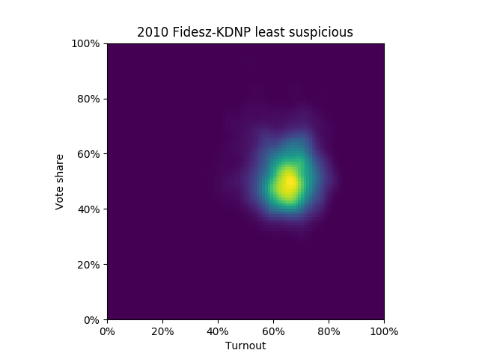
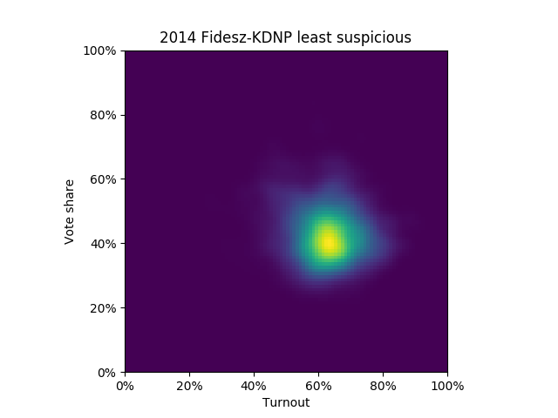
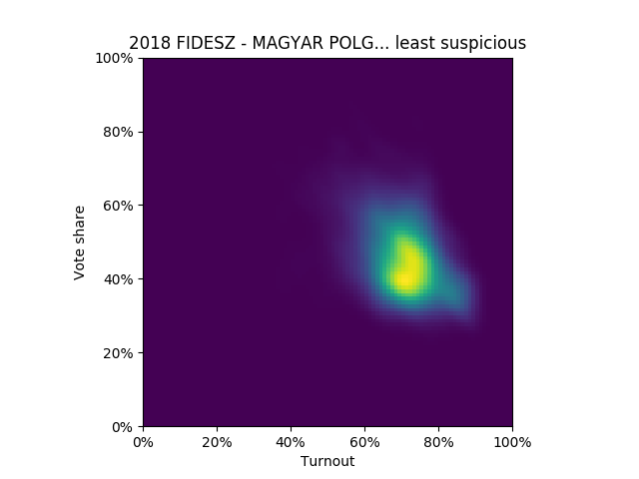
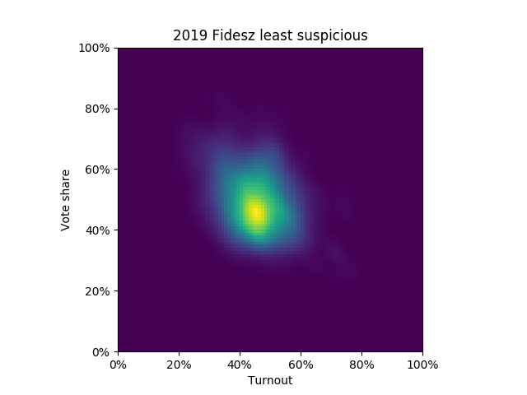
Fidesz Less suspicious municipalities (same group on each chart)
2010
2014
2018
2019
“Round” + Skewed
E.g. the involved suspect group could grow, i.e. could be > 50%
Approx. round

Slide 12
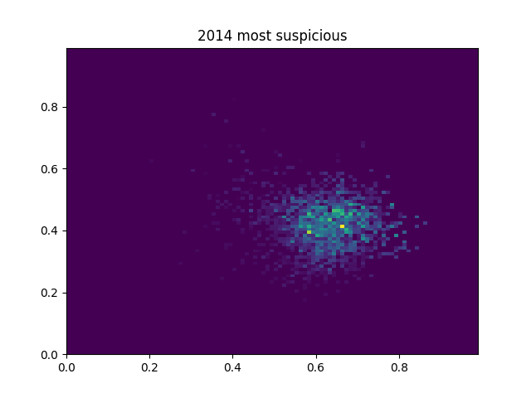
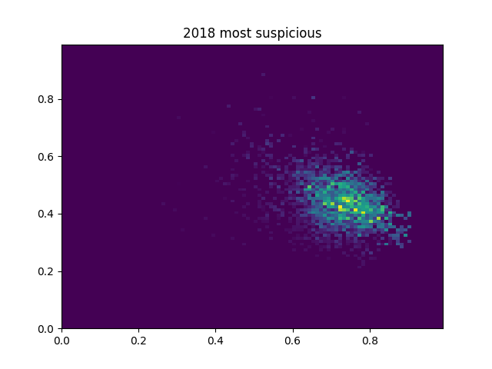
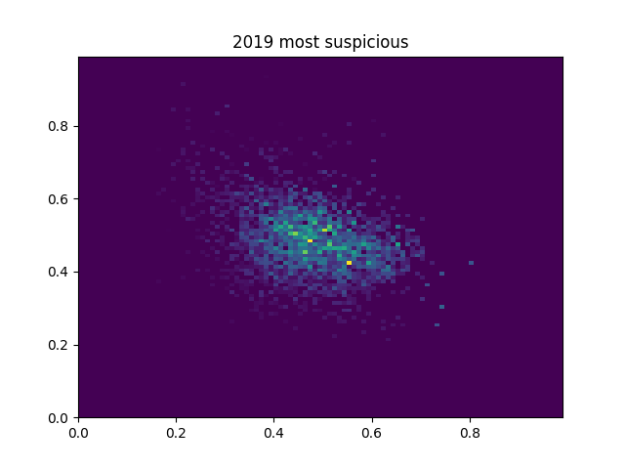
Fidesz More suspicious municipalities (same group on each chart)
2014
2018
2019
Very skewed: Something has happened in the areas of more concern
Brutally skewed, almost flat (bottom “puzzle piece” appears to show up on the right)

Slide 13
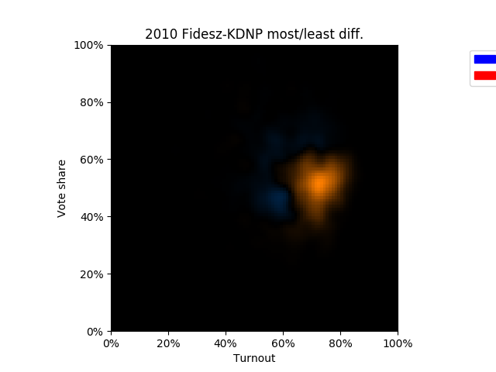
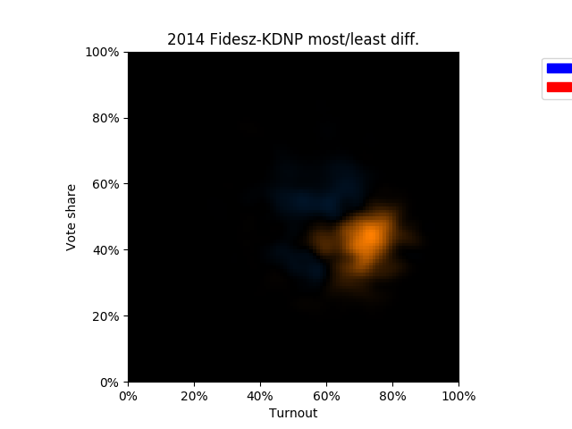
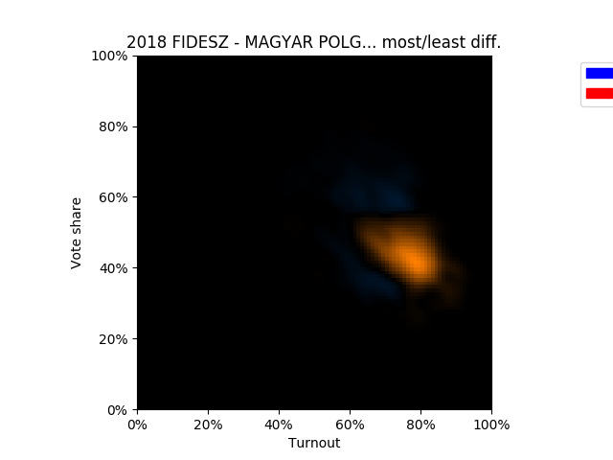
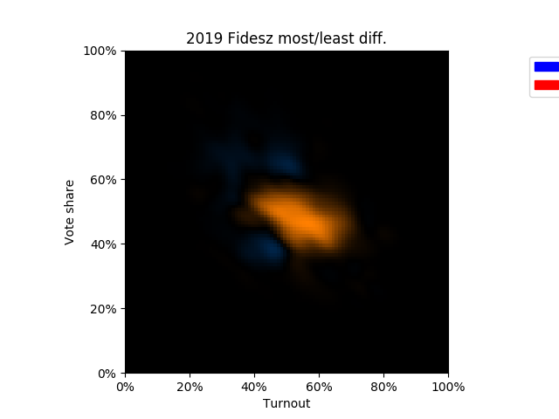
Fidesz Differences between the groups (red: suspicious, blue: less suspicious)
2010
2014
2018
2019
2010-2014: 100-200 thousand extra votes appear in the more suspicious areas. These votes favour Fidesz compared to the average of the affected areas. Such “peaks”, smears are easy to associate with fraud.
2018-2019: An abrupt change: the "peak" gets smeared (more visibly on the previous slide), making fraud more difficult to detect.
However, the magnitude of the difference (150-220 thousand votes) remains constant.

Slide 14
Fidesz: what we may have seen
Where the numbers are more awkward:
There is a bigger turnout (shift towards the right)
Fidesz achieves a more in the beginnings, then this effect gets “smudged”, perhaps becomes consciously hidden (A 2012 paper, to my understanding, seeks fraud based on spot on similar “corners”)
“Cannot fail”

Slide 15
Fidesz: what we may have seen (more detailed)
Horizontal axis: voter turnout
Vertical axis: vote ratio (votes/valid ballots) achieved by the party
2010: a “corner”, smear appears in the top right hand corner
2014: a bigger, flatter smear in the top right hand corner
2018: a clearly observable difference, but it is “smudged”
2019: a starker difference (skewed, distorted distribution over more suspicious settlements), the result: the vote ratio plateaus whilst the turnout is elevated, more precisely set than in the areas that show up “miscounted”
Note that precision, consistency is valuable on its own right already (German state bonds do sell, even irrespective of their negative yield, however it seems fidesz has obtained extra advantage, too).

Slide 16
Possible explanation? (1)
Too few? Wanting to make it certain? Top it up with a few votes! Someone(s) apparently, at certain locations, have inflated the turnout rate (points have been pushed right). It seems as if where he Fidesz votes would have dropped, some votes were added to what seemed to fewish in certain wards, translating the bottom of the patch towards the top right (high vote rate, high turnout direction)

Slide 17
Possible explanation? (2)
For instance, in capital districts (in the third, to name one) can similar dynamics be observed. After all, low and high turnout both favoured Fidesz... :)
It does not mean - perhaps to avoid more fraudulent looks - that it wouldn’t be worth diluting your own with others’ votes. And those left out: sorry (their share will even reduce). Whether their control is a side effect or an aim, is another question.

Slide 18
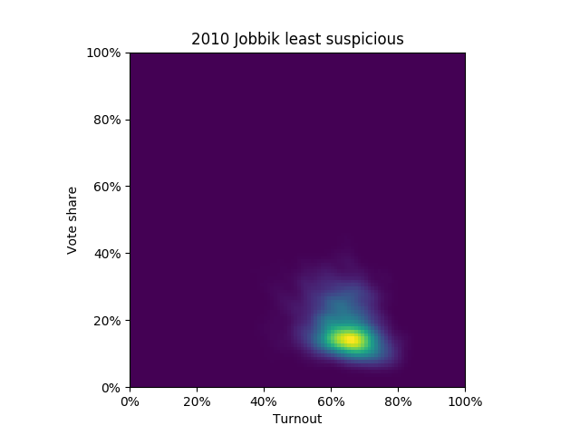
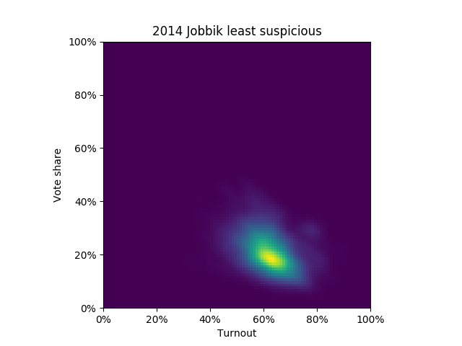
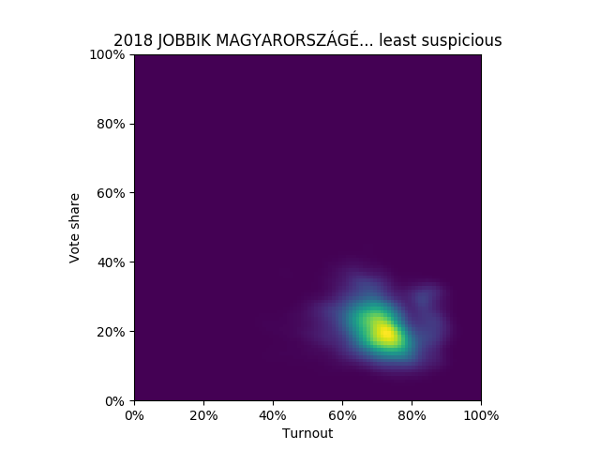
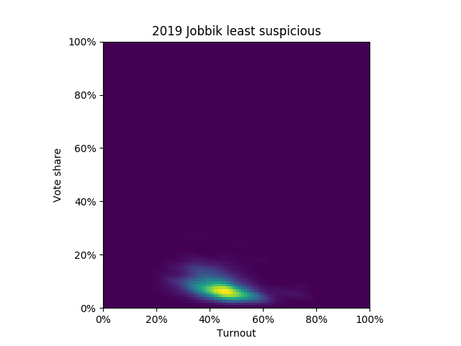
Jobbik Less suspicious municipalities (same group on each chart)
2010
2014
2018
2019

Slide 19
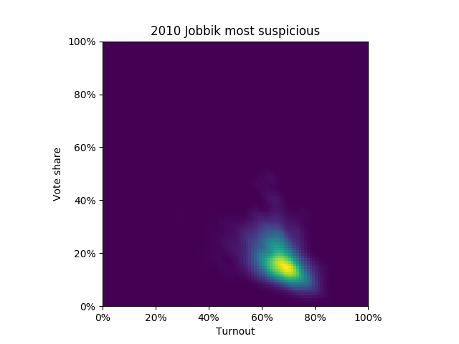
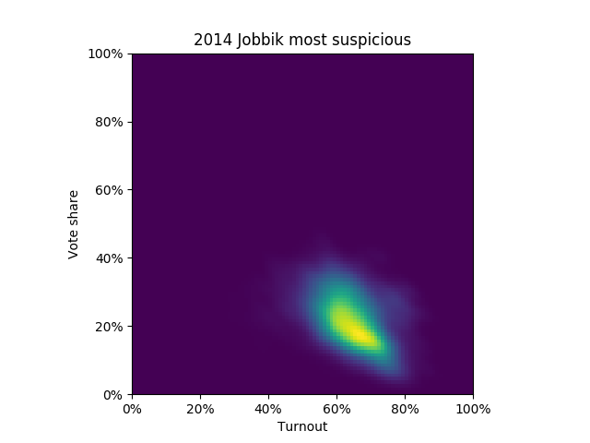
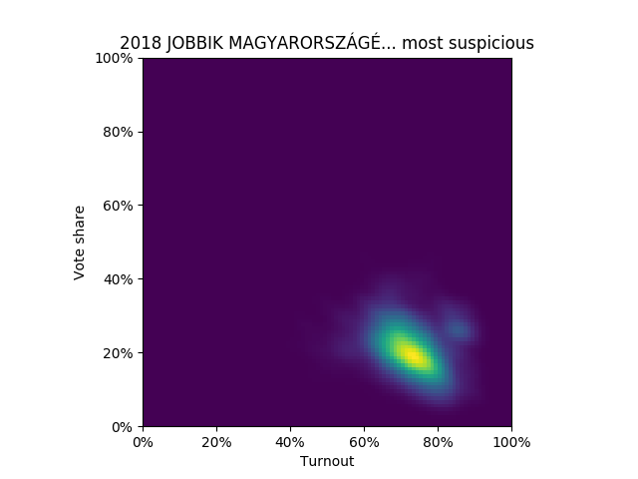
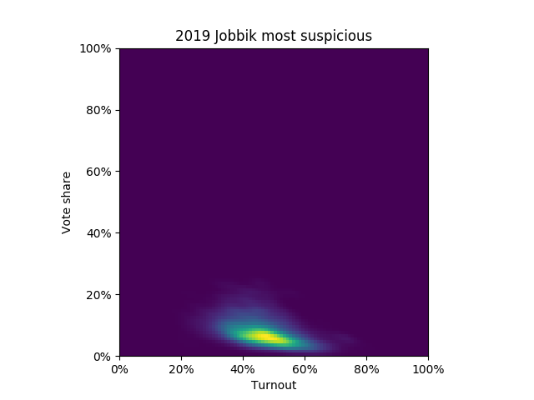
Jobbik More suspicious municipalities (same group on each chart)
2010
2014
2018
2019
As if the votes were dragged down (the bottom right area is more pointed, smeared down/right – increased turnout yielding a decreasing rate

Slide 20
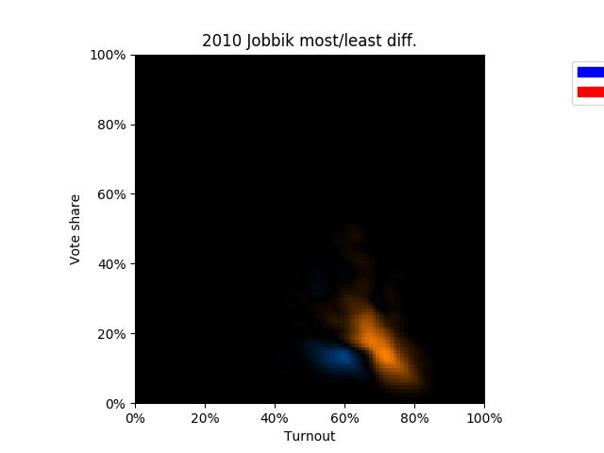
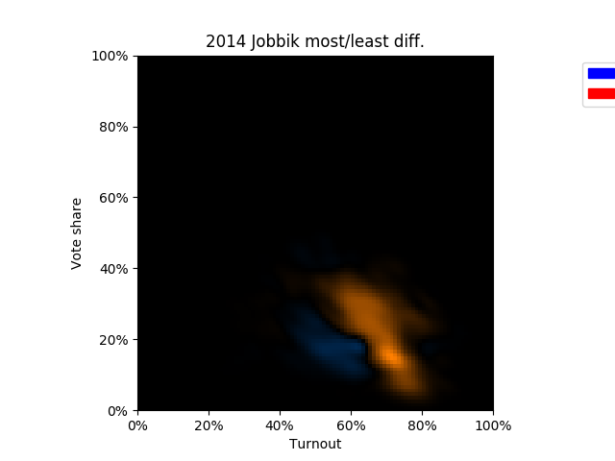
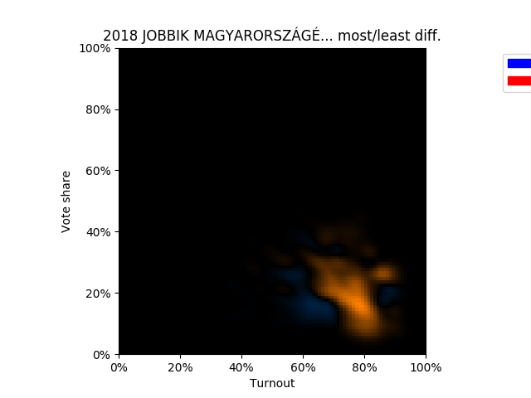
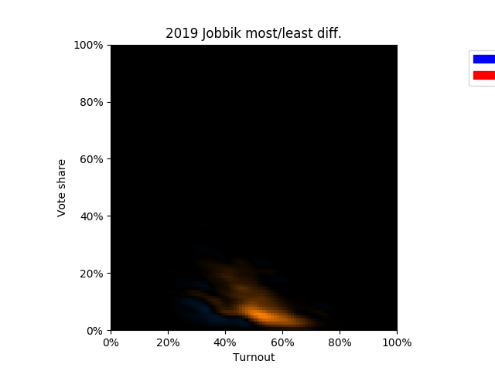
Jobbik Differences between the groups (red: suspicious, blue: less suspicious)
2010
2014
2018
2019
Largely speaking, Jobbik was never lucky, its diagrams all are smeared towards the bottom right corner, in case of fraud this generally would suggest that it received none or few of the extra votes, whilst others did. In the given case it seems it didn't receive any, apart from small patch, perhaps noise.

Slide 21
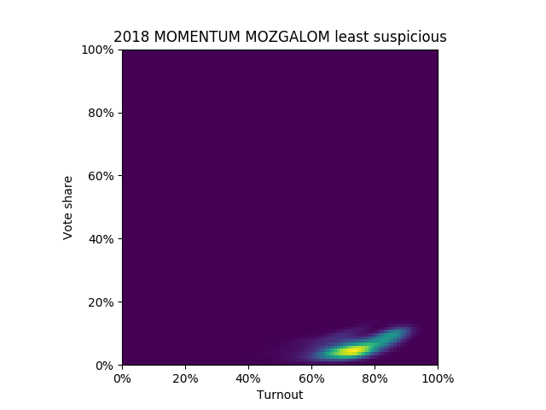
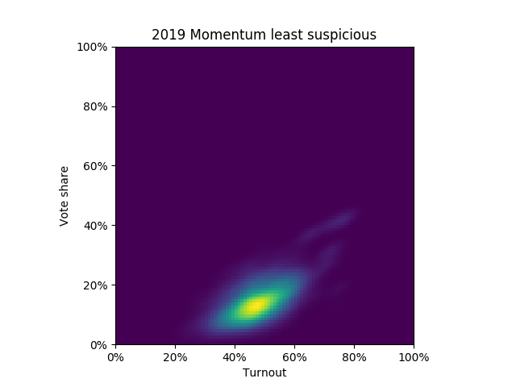
Momentum Less suspicious municipalities (same group on each chart)
2010
2014
2018
2019

Slide 22
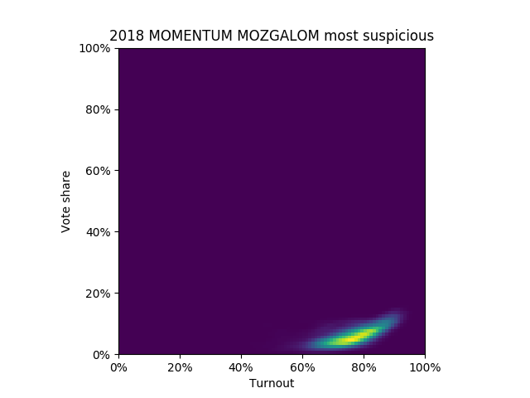
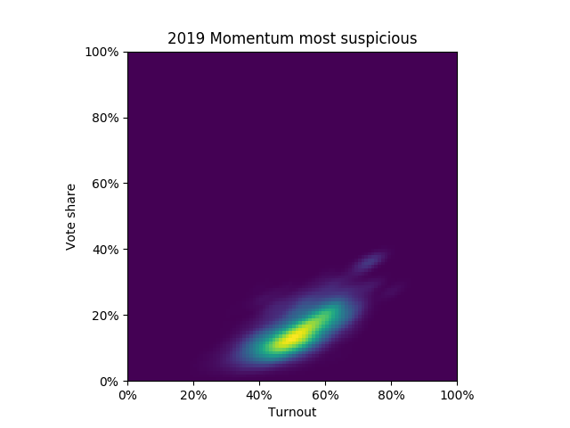
Momentum More suspicious municipalities (same group on each chart)
2010
2014
2018
2019
As if it was smeared a bit up, a lot in 2019 (the top right hand corner is more pointed, stretched - a disproportionately growing vote share)

Slide 23
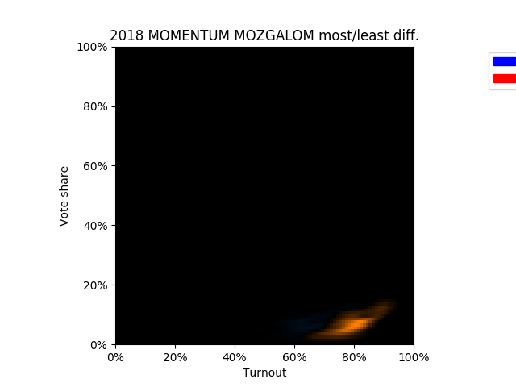
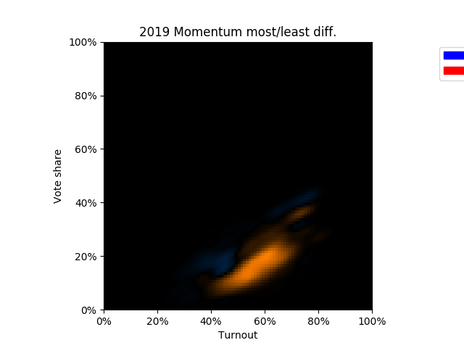
Momentum Differences between the groups (red: suspicious, blue: less suspicious)
2010
2014
2018
2019
That "small" difference in 2019 is in the order of 50,000 votes -- while other parties also gain more votes, in this year the clear favourite is Momentum. (But do wait with stoning them! There's more to come...)

Slide 24
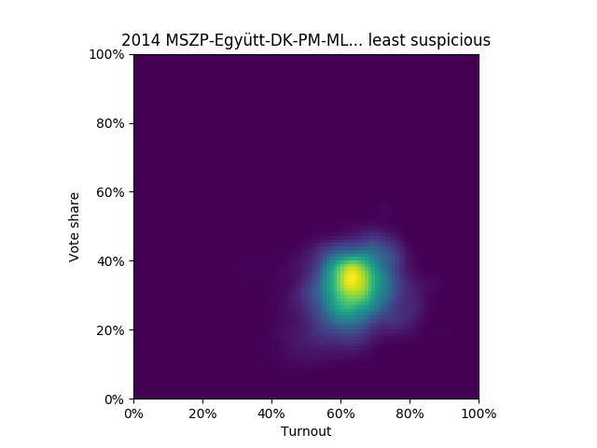
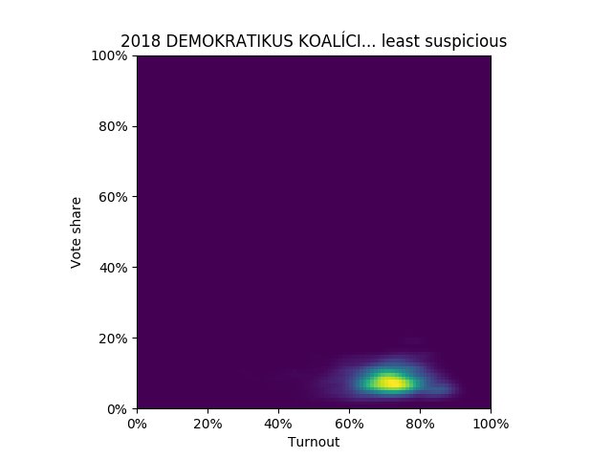
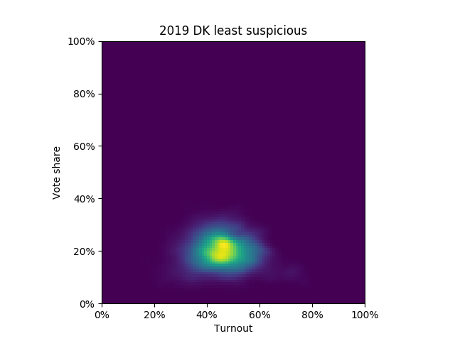
DK Less suspicious municipalities (same group on each chart)
2010
2014
2018
2019
(Part of a joint party group)

Slide 25
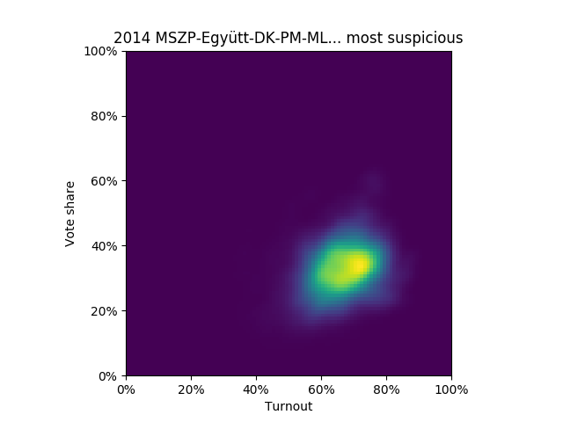
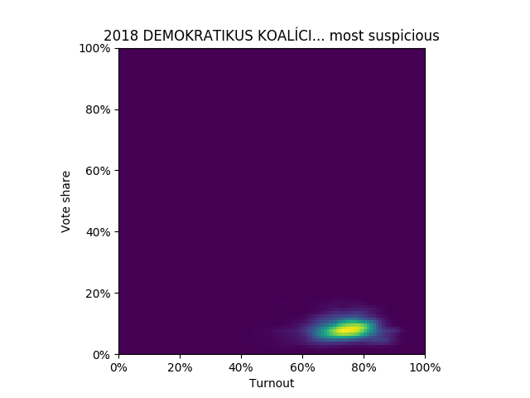
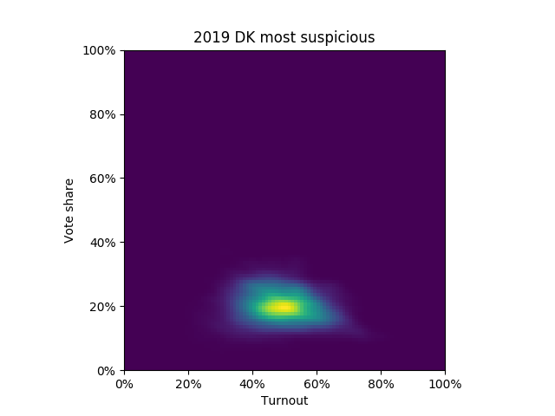
DK More suspicious municipalities (same group on each chart)
2010
2014
2018
2019
(Part of a joint party group)

Slide 26
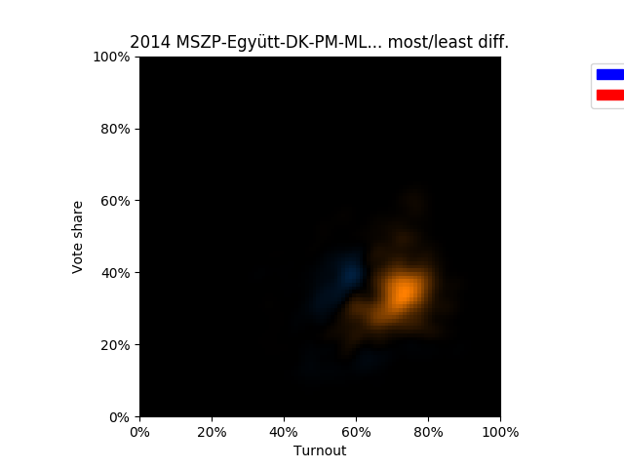
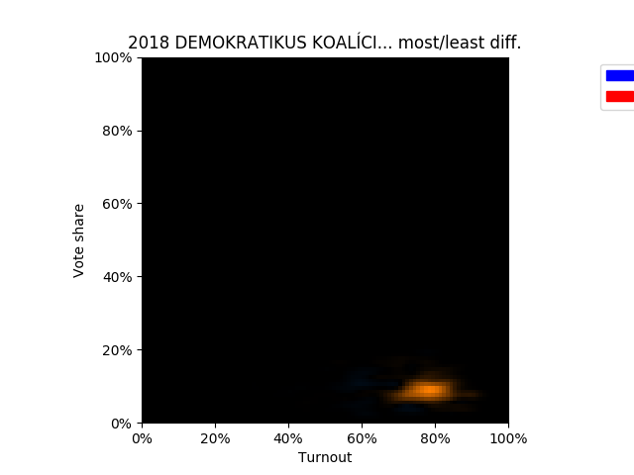
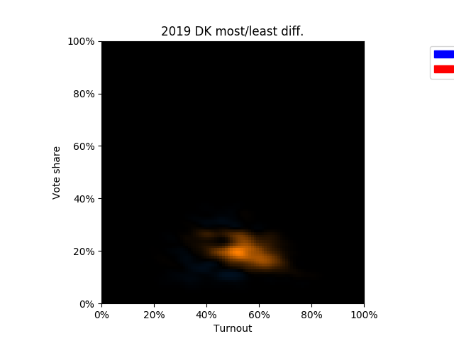
DK Differences between the groups (red: suspicious, blue: less suspicious)
2010
2014
2018
2019
(Part of a joint party group)
The joint effort, and then the standalone DK had apparently not been influenced by the hypothetical extra votes right up till 2019.
But then it seems as if it was dragged down - which is plausible, since it could show up as a serious contender. (Second biggest party then.)

Slide 27
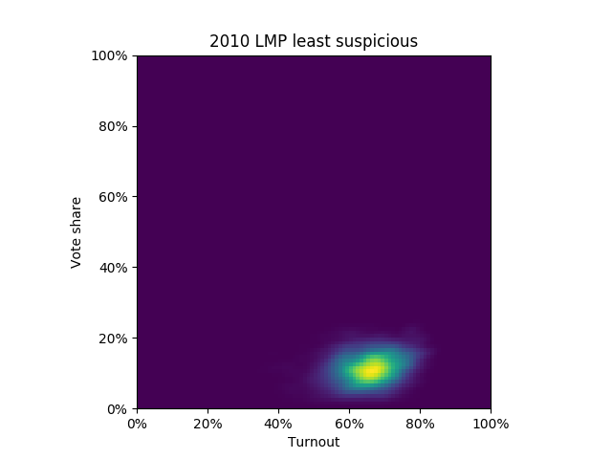
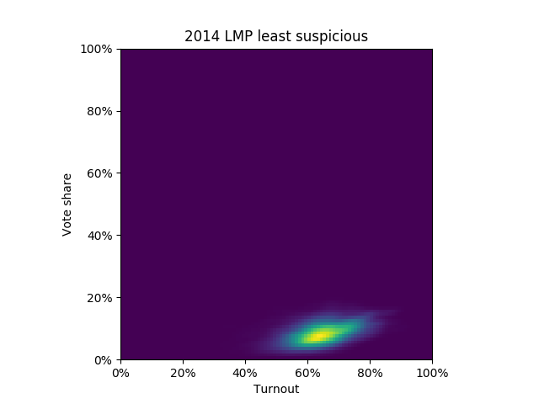
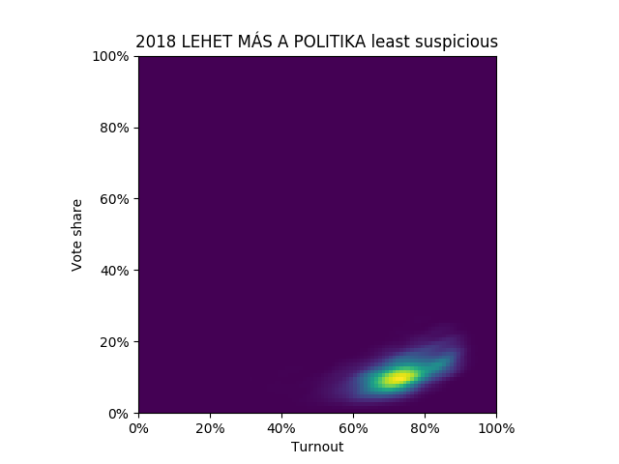
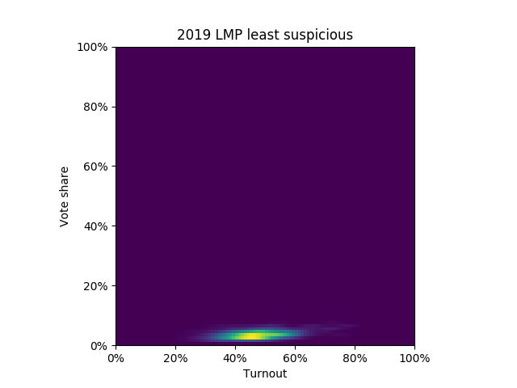
LMP Less suspicious municipalities (same group on each chart)
2010
2014
2018
2019

Slide 28
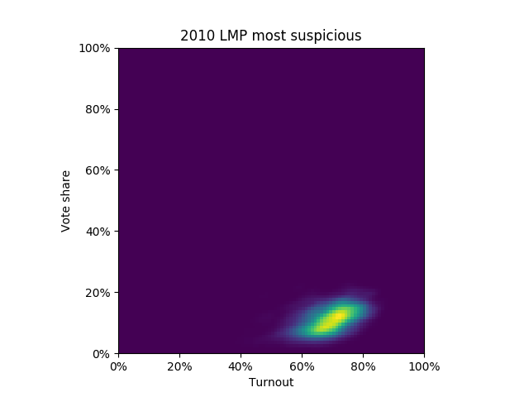
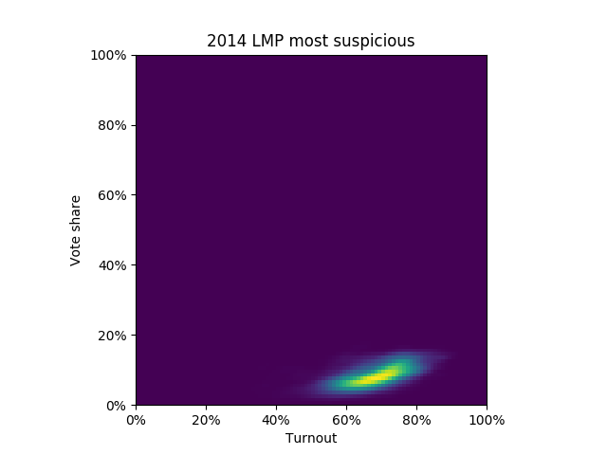

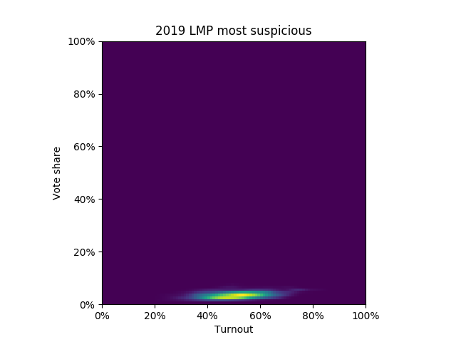
LMP More suspicious municipalities (same group on each chart)
2010
2014
2018
2019

Slide 29
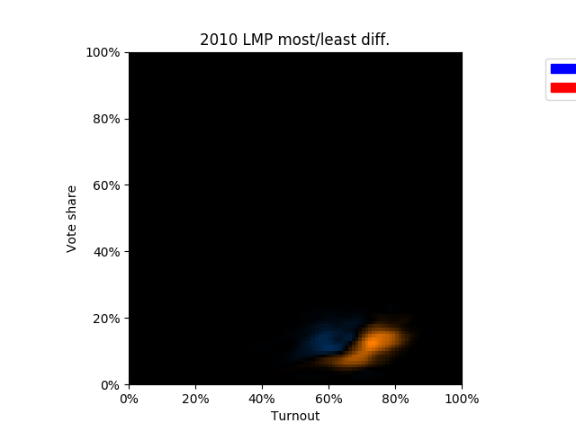
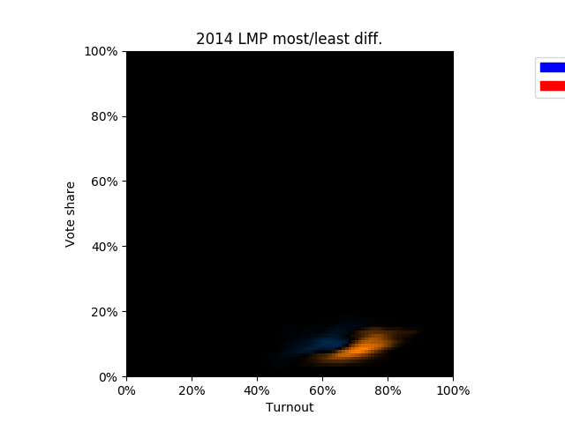
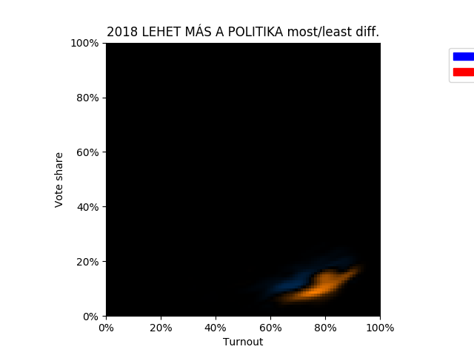
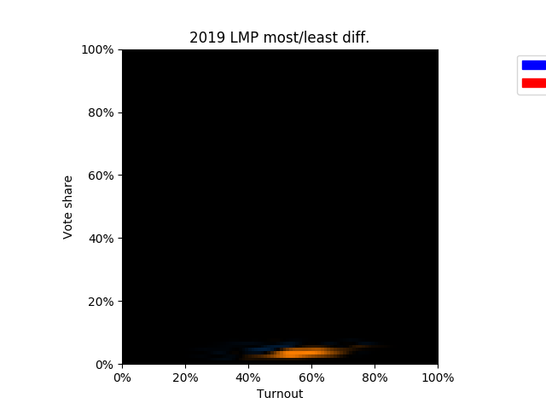
LMP Differences between the groups (red: suspicious, blue: less suspicious)
2010
2014
2018
2019
In 2010, 2014 and 2018 as if it was inflated (like as if the centre shifted towards the top right hand corner), in 2019 it doesn't seem to be favourised.

Slide 30


Együtt (outside coalition) Less suspicious municipalities (same group on each chart)
2014
2018
2019

Slide 31


Együtt (outside coalition) More suspicious municipalities (same group on each chart)
2014
2018
2019
As if it was more unleashed (perhaps left intact) in the suspect areas.

Slide 32


MSZP Less suspicious municipalities (same group on each chart)
2010
2014
2018
2019

Slide 33


MSZP More suspicious municipalities (same group on each chart)
2010
2014
2018
2019

Slide 34


MSZP Differences between the groups (red: suspicious, blue: less suspicious)
2010
2014
2018
2019
It seems if it was inflated in 2018, but in 2019 it bumped into a ceiling (a relatively steady vote share over the turnout range, i.e. the stretch is horizontal on the right, and the upper "noise" disappears over suspect areas, too)

Slide 35
What we may have seen
Update: the below numbers are soon to be improved upon.
Based on the new diagrams, the apparent intervention was much more advantageous for Fidesz than what so far has been unveiled.
We can estimate, towards (or beyond) what ratio the differences point:
 | Fidesz | Jobbik | Momentum | DK | LMP | MSZP | Mi Hazánk
2014 | -12% | 105% |  | 19% | -18%
less suspicious | 41% | 23% |  | 27% | 5,4%
2018 | 39% | 21% | 5.7% | 9% | 5% | 14%
less suspicious | 43% | 19% | 4,2% | 6,7% | 8,6% | 14%
2019 | 46% | 7,1% | 15% | 20% | 1,8% | 4,5% | 2,4%
less suspicious | 47% | 5,6% | 13% | 18% | 2,5% | 7,4% | 3,0%
2019 final | 53% | 6,3% | 10% | 16% | 2,2% | 6,6% | 53%
poll | 42-55% | 9,7%-13% | 3%-7% | 6%-11% | 3%-5% | 8,5%-13% | 1,0%-3,2%
Bold/italic typeset denotes values that appear strongly/less strongly adjusted (at most 95%/100% relative deviation compared to the more suspicious)
Table: what vote mix could be received by the suspicious areas in excess, which party values seem adjusted. It is assumed that exclusively manipulated mixes those were added to the other, which can only be an approximation. The less suspicious areas' votes are displayed in the bottom rows. Finally, the election vote results and the typical range of the preceding poll based estimates.
(If we accept that a smaller overall deviation ~ greater degree of manipulation ... however, there can be surprises, such as multi-modality, as well as other details to control for, such as trends in the relationship - this will more than likely change, improve.)

Slide 36
What we may have seen
2010-2014.
The areas (at least) later becoming suspicious looking the visual difference is much smaller in these years. Despite the deceitful look these “small differences” still represent a ward group of hundrends of thousands (150-220 thousand) votes for Fidesz alone. Obviously with other party results the volume of influenced votes can easily reach up to a 400 thousand range.
2018.
Fidesz receives a lot, Momentum also benefits, and a little less, but DK and MSZP are also on the beneficiary side of the extra votes. Yet, Fidesz does not reach up to its final country-wide average, these may not be Fidesz-friendly areas. Jobbik is more on the loser side of this game.
2019.
Fidesz consistently receives the votes. Momentum is preferred. MSZP and LMP are dragged down: presumably towards votes covering 1 and 0 mandate. The purpose of Mi Hazánk is apparently to receive votes for half of a mandate, i.e. to eat up the votes - perhaps to increase the EP threshold in Hungary.
MSZP seems to bump into a ceiling: strikingly rarely receives more than a certain vote share.
Remark: based on early, but more detailed examinations Momentum has been pulled downward (too?) in the capital.

Slide 37
Strategy - divide and conquer?
If you can manipulate, overwrite the votes, but you wouldn’t like it to be too obvious
Guarantee your share, don’t rig it too strikingly, but as a bare minimum, do not lose largely anywhere (perhaps get your excess votes transferred to the weaker areas?)
Part of the capacity can then be “wasted” on controlling the opposition, as you deem favourable E.g. don’t allow the most worrying o close up on you
And then keep switching between favourites! So that then never will be any credible, long lived opposition party on the scene ... they remain weak (e.g.: unleash Jobbik, then bin it, unleash LMP, bin it, drag Momentum down in Budapest, but strengthen it elsewhere, perhaps in very isolated die hard Fidesz supporter towns?)
How to further multiply your votes in a difficult to detect way? Increase the turnout, keep your (and your protegées) vote rate near constant For instance, on an EP election this will increase the electoral threshold, whilst you, and the preferred ones will almost fly over it, and those not making it will mostly be strengthening your (the majority winner's) positions

Slide 38
Doubtful supermajority (1)
The earlier values will be improved. The magnitude in certain cases is expected to grow.
Based on the current diagrams
In 2010-ben 220, in 2014 175, in 2018 200, in 201 150 over thousand suspicious Fidesz votes are of concern.
It is easily possible, that fidesz-kdnp has never had a supermajority.
Similarly in 2018, even based on the old, rougher considerations:
Since in 2018 the suspect areas have seen an additional about 11% turnout, whilst in 2014 the difference was about 3%. Thus, a 8% extra gap could have appeared due to the above stuffing.
Fidesz could have received about 78,000 additional votes due to the 11% difference. Of this, the "bonus" part, 8%, may have yielded largely 56,730 votes. This isn't much (but honest work lol :) sorry), but knowing Fidesz to a degree, without any bad-mouthing it should be noted that it (could have) rigged the election in other ways too, in these areas, let alone others.

Slide 39
Doubtful supermajority (2)
These values will be improved upon. The magnitude in certain cases is expected to grow.
This alone represents 2% of all the list votes the Fidesz-KDNP coalition has received. Meaning an extra mandate very easily to be lost.
What seems very likely according to this, too:
The vote numbers were overwritten, the election results should be invalidated, new, legitimate elections should be held
No supermajority (⅔) since 8 April 2018 (and isn’t at all guaranteed since 2014 either)
The government is carrying out a “stealth coup d’etat”
It is worth watching the prime minister, what facial exercises he uses before fibbing :
“The high turnout marginalizes every concern”
(Another option is he’s not even heard of ballot stuffing. Realistic? Maybe. Probably he’s just lying.)

Slide 40
2019: ?
It may come as a surprise, that whilst by 2019 the turnout fell to 2/3 (to 43.48% from 70.2%), instead of the difference reducing proportionately, still almost the same amount (from 78,000 it only fell to 70,000) of extra votes were received by Fidesz in the areas with suspicious vote counting. Like as if they just kept cheating as much as they could, not in proportion? Perhaps this is why the 2019 charts are so vastly different.
We should be careful at even estimating what the true 2019 results could have been (of course, only if there was any rigging). Of course, sooner or later ...

Slide 41
What follows from this?
Fidesz for at least a year, probably - besides other, nevertheless disgusting methods (vote buying, carousel voting, etc.) - has been having a supermajority via a systemic electoral vote counting fraud. As many conjecture: they perform puppetry with the opposition. If so, for instance, possibly in this way.
I feel deeply sorry for Együtt 2014 (a party dissolved in 2018), the unreasonably resigned LMP and (albeit I am slightly more of a left wing voter) Jobbik leadership. Perhaps they will return?
These all could have been executed by the "apparently" Fidesz fraud machine, the "Mi Hazank" and similar traitors, still embedded in Jobbik (sad fact to face: Paks 2 was voted by Jobbik as well), privatisation billionaires (sorry Mr. Gyurcsány from DK), etc.
Perhaps we hardly have any reliable opposition. Perhaps this is why DK and Momentum has won big time: Fidesz wanted easy, perhaps controllable opponents. Who knows. May it not be so …
Whether or not we have a strong opposition, this government, stuck onto our shoes, needs to be removed from there.

Slide 42
Mit tehetünk? (0)
Van ötleted?
(Nem baj, ha nem jön egyből, és megvárod…)
Ha már tényleg nincs, lapozz ...

Slide 43
Mit tehetünk? (1)
Számold te is, jelentkezz!
Ősszel mindenképp, amennyire csak tudjuk, meg kell gátolni a csalást! Szeptember a jelentkezési határidő, a pártoknál esetleg utána is tudsz http://szamoljukegyutt.hu/ Ha valami furcsát tapasztalsz, oszd meg másokkal!
Írd alá a petíciót az EBESZ felé, hátha ők is jönnek a választás tisztaságát vizsgálni Itt: http://chng.it/S4K6drsS

Slide 44
Mit tehetünk? (2)
Tüntessünk (minimum! és jókor!) a kormány ellen A választásokkor mindenképpen! Lássák a bizonytalankodók is, hogy van ellenzék, hallják, milyen tróger banda a Fidesz, és hogy nem félünk tőlük! Sem most, sem máskor! Nincs kétharmaduk! (Amit amúgy is csak ők találtak ki...) Pesten, vidéken (talán a falvakban is, de jó is lenne). Először szinte biztos a városokat tudjuk visszaszerezni. Talán már meg is történt, csak a hivatalos számokban nem látszik még!

Slide 45
Mit tehetünk? (3)
EP támogatás szerzése
Közvetísd európai parlamenti képviselők felé, mi történik – Twitteren, Facebookon, Emailben, Levélben, ahogy éred!
Igenis merj politizálni!
Ha hiszel a pártoknak, ha nem. Továbbra sem vagy egyedül! Nekünk kell összefogni, hallatni a hangunkat, és megváltoztatni a rendszert!

Slide 46
Aki tud valamit, tényleg jelentse!
Míg nem őt jelentik! ☹ Például a TASZ (Társaság a Szabdaságjogokért) felé:
https://tasz.hu/
“A demokratikus rendszerekben a választójog általános, egyenlő, közvetlen és titkos szavazással érvényesül.”

Slide 47
Nyílt szavazás? Benne vagy?
Választójog “A választópolgárok a szavazat tartalmának nyilvánosságra kerülése nélkül titkosan adhatják le a szavazatukat.“
Ha nincs elég jelentkező a szavazatszámlálásra, vagy nem bízunk bennük, részemről akár nyíltan is szavazhatunk.
Én biztos nem titkolom, hogy egy ideje nem a Fideszre szavazok, és nem is fogok egyhamar. Azt titkolnám, ha rájuk szavaznék …! 😇

Slide 48
Szervezkedj!
Vagy legalább teremtsd meg az esélyét! Keress egy embert, akivel egyetértesz, akiben megbízol, aki számít.
És aki ki mer menni az utcára is, ha kell.
És aki ha kimegy, te is kimégy! (Szerencsés lehet, ha nem lakik túl messze.)

Slide 49
Ellenőrizd a szavazást (akár utólag is!)
Számadatokat itt (is) találsz:
https://www.valasztas.hu/
Te döntöd el, hogy elhiszed-e őket, vagy sem. Szokj hozzá, hogy ellenőrzöd! Ha gyanús, ne maradj csendben! Nincs se a szomszédban, se környéken egy fideszes? Akkor hogy lehet a körzeti eredményük 50% felett?

Slide 50

Exit pollok
Exit pollokkal nehéz vitatkozni. Emlékszel? Londonban valahogy így nézett ki a Fidesz eredménye 2018-ban (igen, az 5. volt):
Ehhez képest jellemzően nincsenek exit polljaink. Főleg egy-egy szavazókörre.
Miközben mennyiből is vitelezték ki ezt? Lelkes emberek megkérdezték az embereket. Minden tiszteletem az övék. Te is meg tudod csinálni, ha megkérdezed, biztos szívesen elmondják, hogy kell. Hajrá! Esetleg Ti is csináljátok meg!

Slide 51
Ne add fel!
Mi se fogjuk!

Slide 52
Disclaimer
None of the above is 100% certain, it involves a lot of speculation, but there is almost certainly a lot of truth to it.
The analysis is still in progress, has not been professionally peer reviewed. It will expand in terms of coverage and quality.
It is You who decides what you believe, and do not hurt anyone, especially without a very good reason!
The change of systems has clearly not yet been finished ... this can be a difficult period for everyone.
The analysis is being created here

Slide 53
For updates, follow the Tüntetés facebook group or the GitHub repository
Acknowledgement
Miklós Vázsonyi (Platón Party) for the repeat inspiration, data, for the latter Kálmán Andrásnak as well
Old friends, who have born that I disappeared for more than a few weeks, and helped with reviewing
The entire opposition, including:
Daniel Gárdonyi, Teréz Mézes, Viktor László Kondor, Szofi Kovács, who keep things in motion in the meantime … and everyone left out! The cover photo is the work of Tibor Végh, source
Sorry
About all potential mistakes. It is A̶u̶g̶u̶s̶t̶ mid September, and it all is late already. And: keep quiet, nobody’s paying for this :)
Created by
János Brezniczky 2019. 08. 13.

